Slide 1

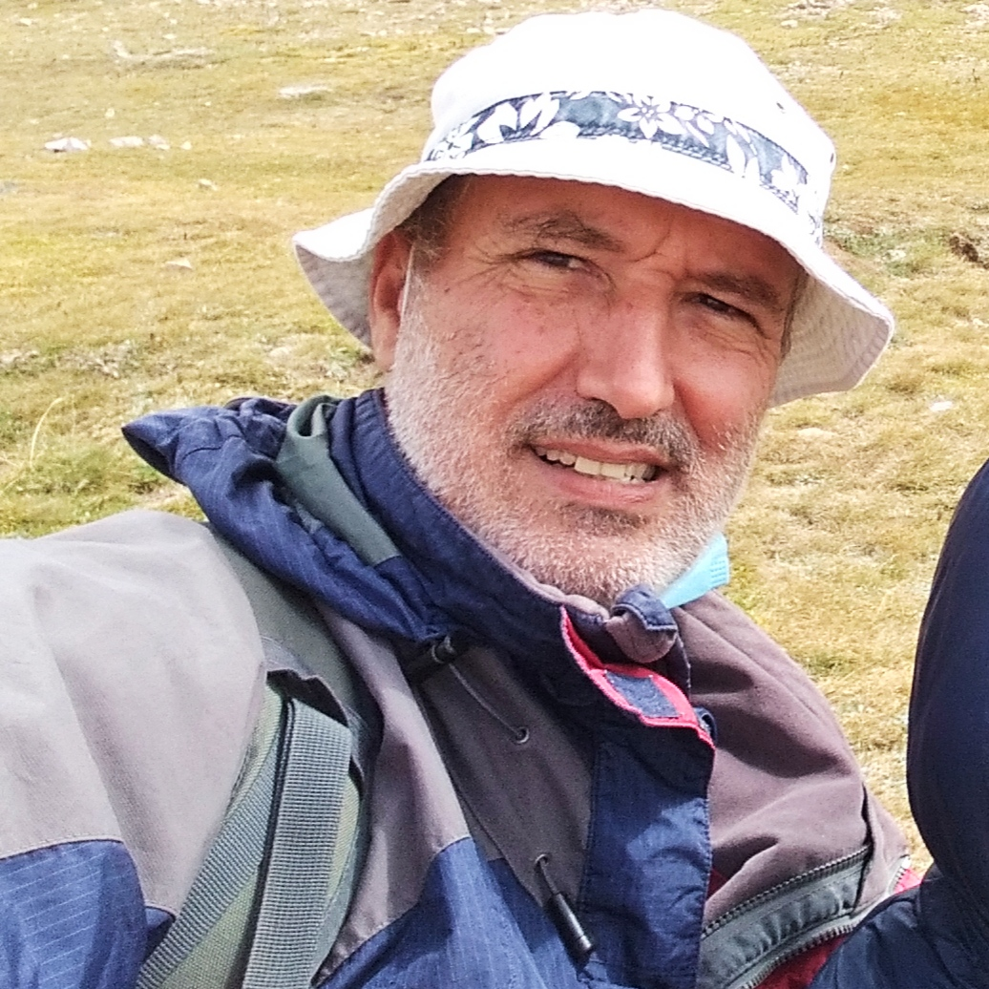
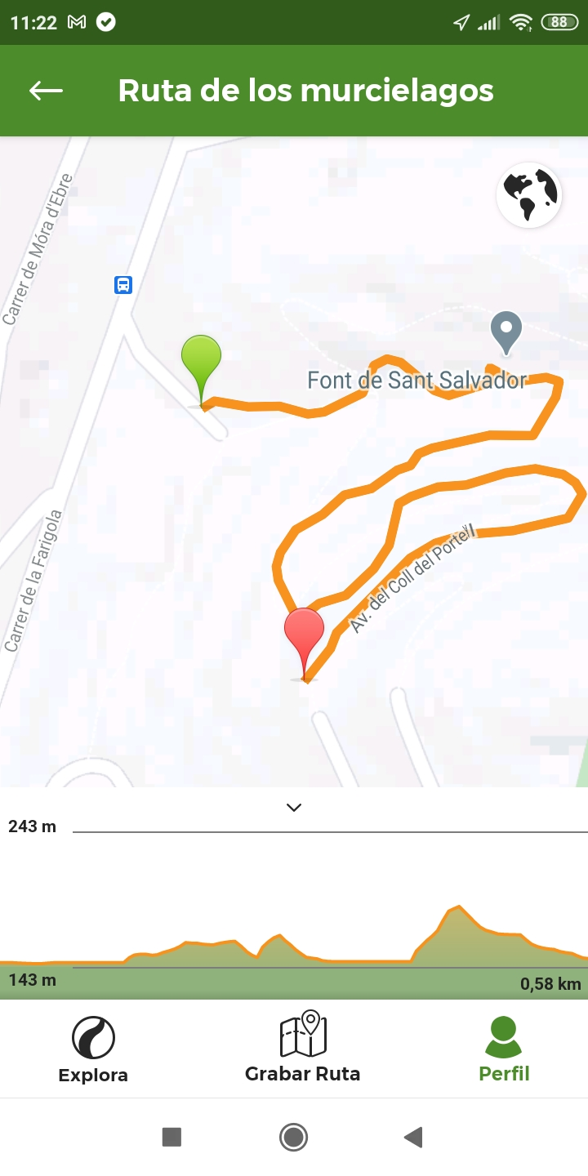
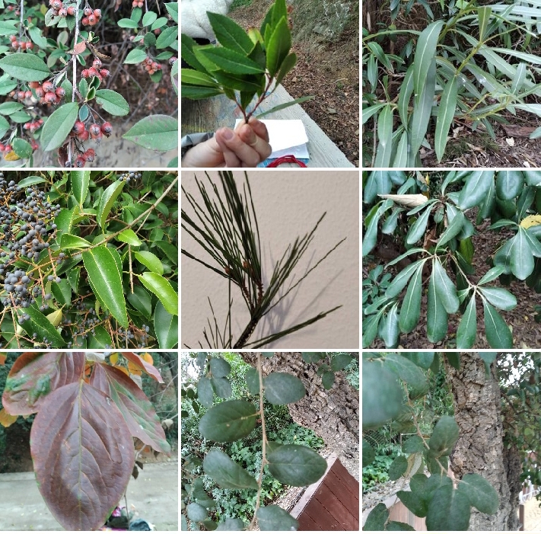
This Week with Mr. Forest
Nov 30-Dec 03/2020
Designing A “Botanical Trail” to learn about plants and their cultural use in Catalonia: Part 1
AIM: For students to design a Botanical Trail from where to learn the diverse flora around their school and be able to share its features with others (Parents, Community at large).
OBJECTIVES: • Students will select their trail based on their favorite places on Turull forest. • Students will practice their English vocabulary and oral competence (names of plants, medicines, etc.) • Students will learn to employ technologies to identify plants, and design maps.
MATERIALS:
✔️ Map of Turull Forest near school,
✔️ camera
✔️ App (Wikiloc, PlantNet, etc.)

