Slide 1

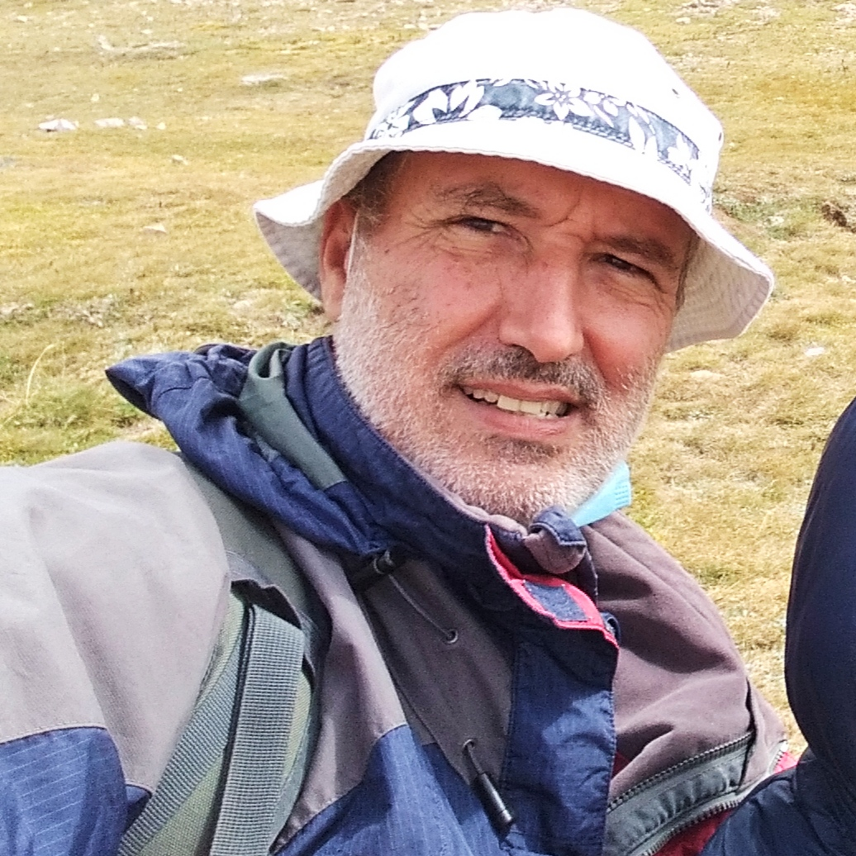
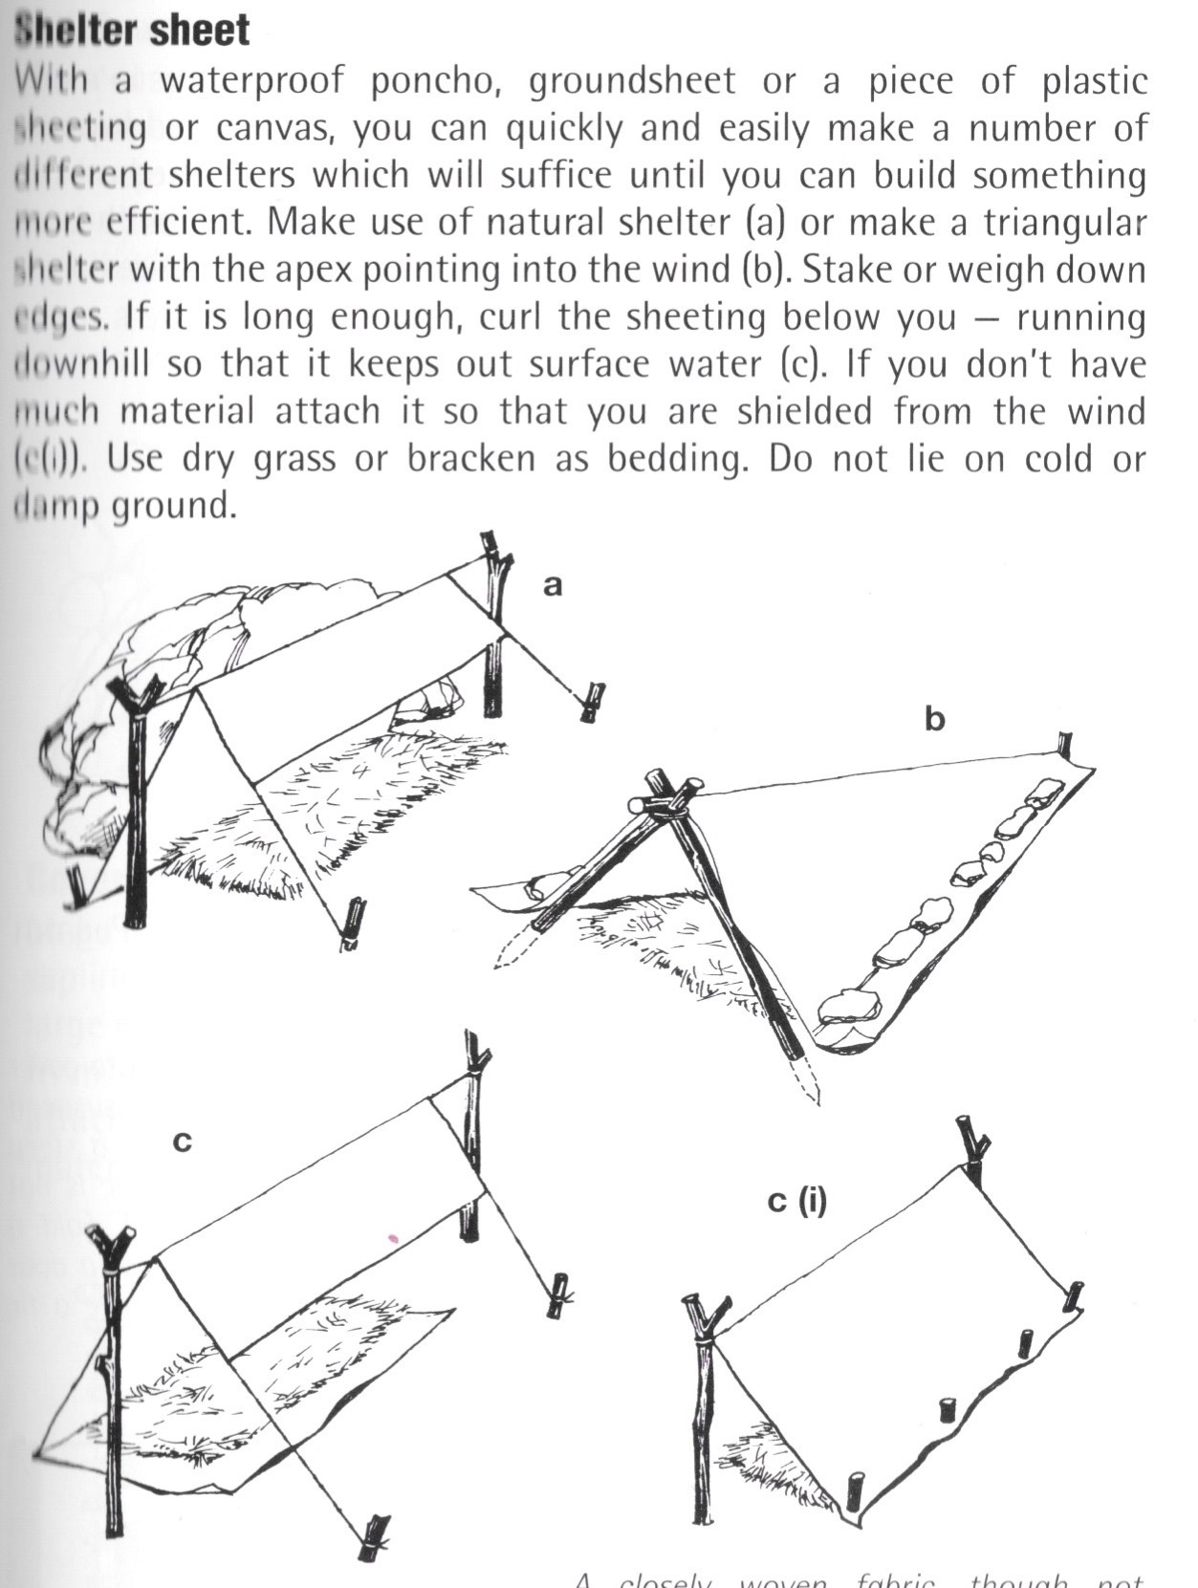
This Week with Mr. Forest
18-21/01/21
Learning to Make a Shelter with
Poncho in the Forest.
AIM: For students to begin to develop an awareness of the Forest as a protective environment, and to gain basic survival skills.
MATERIALS: 1 poncho, 1 string (25 meters.)
OBJECTIVES: •Students will learn to build a shelter with a poncho (using their winter clothing for shelter). • Students will practice their English vocabulary and oral competence. • Students will understand that the Forest can be a resourceful environment.

