Slide 1

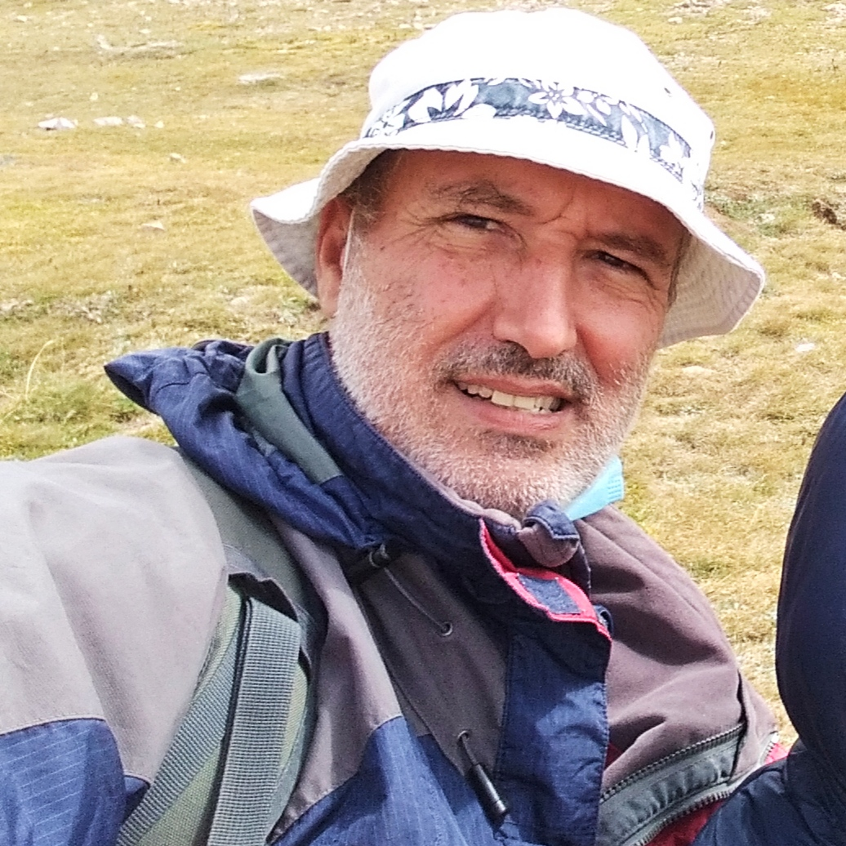
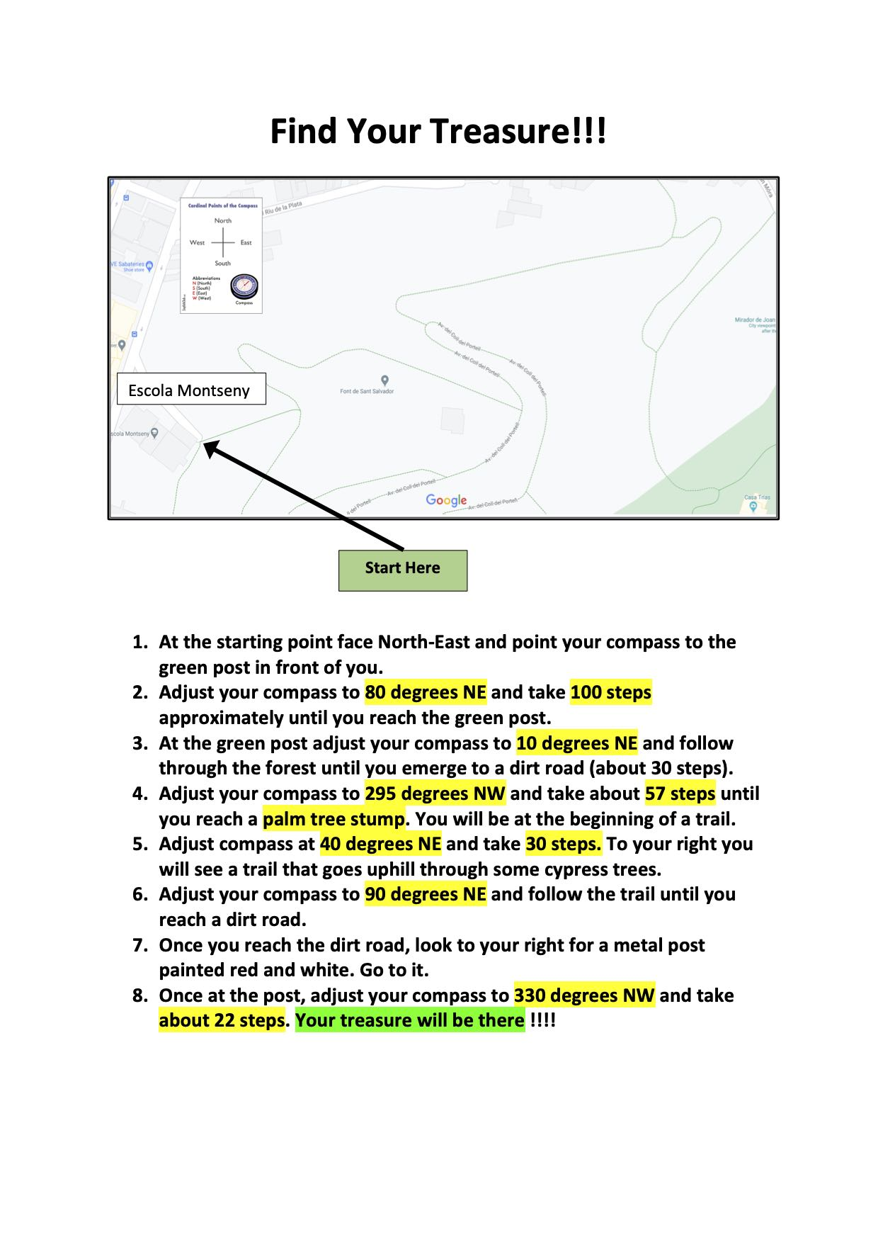
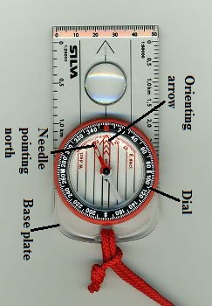
This Week with Mr. Forest
25-28/01/2021
Learning to Use a Map and a
Compass to Navigate in the Forest.
AIM: For students to begin to learn how to travel inside of a natural environment (a Forest),
OBJECTIVES: •Students will learn to use a compass and a map to navigate through the forest • Students will practice their English vocabulary and oral competence (follow directions) • Students will understand how to follow directions within a natural environment (a forest).
MATERIALS:
✔️ Map of Turull Forest near school,
✔️ A Compass
✔️ set of directions (see right sheet)

