Slide 1

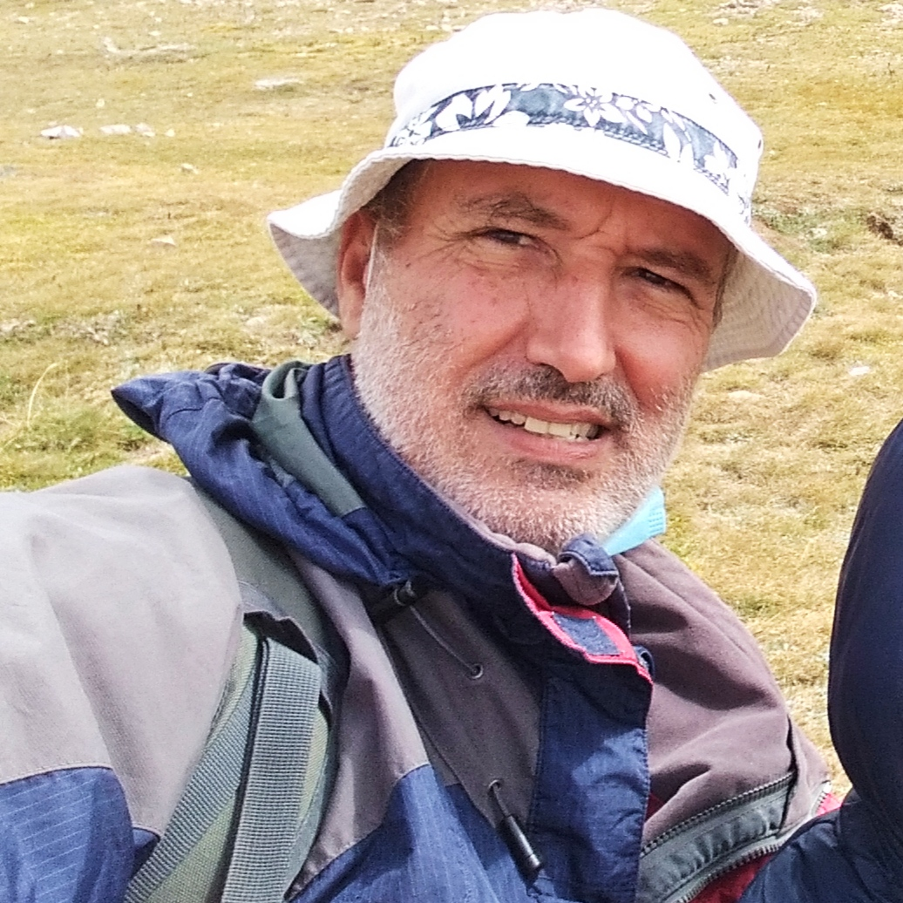
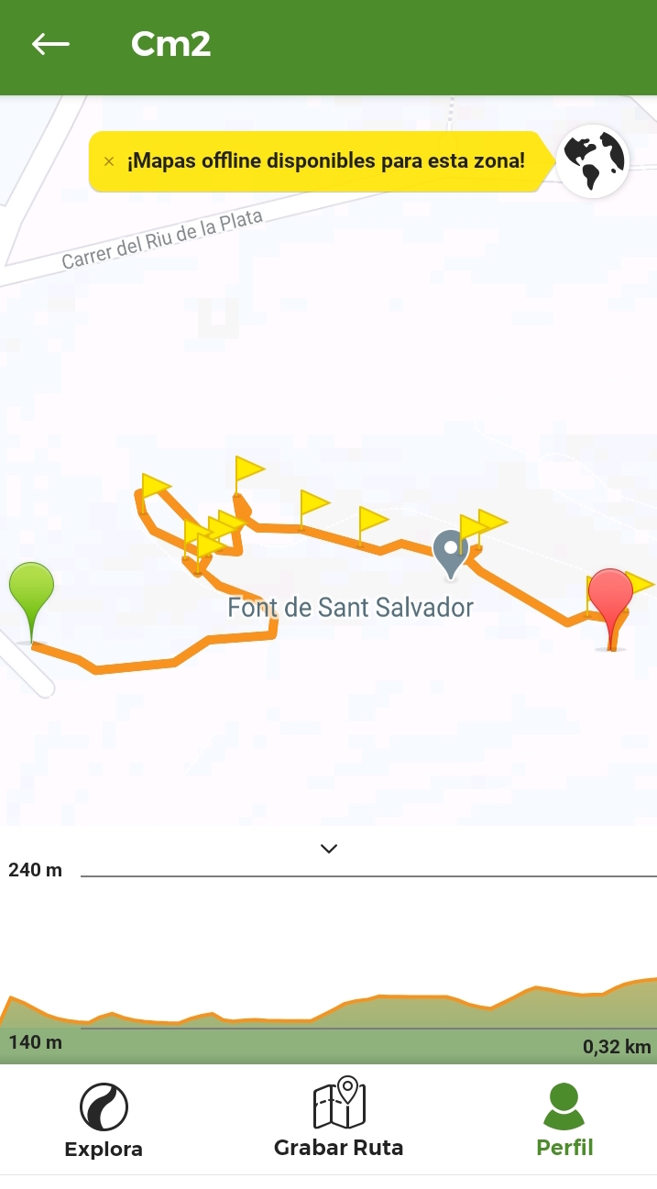
This Week with Mr. Forest
16-18/02/2021
Identifying & Understanding Medicinal & Ornamental Plants in Our Forest
OBJECTIVES: •Students will identify plants along their group’s Nature Trails. • Students will practice their English vocabulary and oral/listening competence. • Students will learn to recognize the cultural uses (medicinal & ornamental) of local plants.
AIM: For each students to recognize the cultural and social relation ofthe local community with the Forest surrounding such community.
Activity: Groups of 3 students identify a plant in their existing nature Trail as a candidate for medicinal & ornamental uses. Instructor will identify such plant using PlantNet App., and reveal to the group if there are possible medicinal and/or ornamental uses of the plant. The photo gets imbedded into the group’s trail if that is the case. Instructor and will give the name of the plant to one member of the group (recorder), and the group will investigate the medicinal and ornamental uses of the pant and send the information to Instructor.
MATERIALS:
✔️Movil phone,
✔️Wikiloc App. (Trails for each group
✔️PlantNet App.

