Slide 1


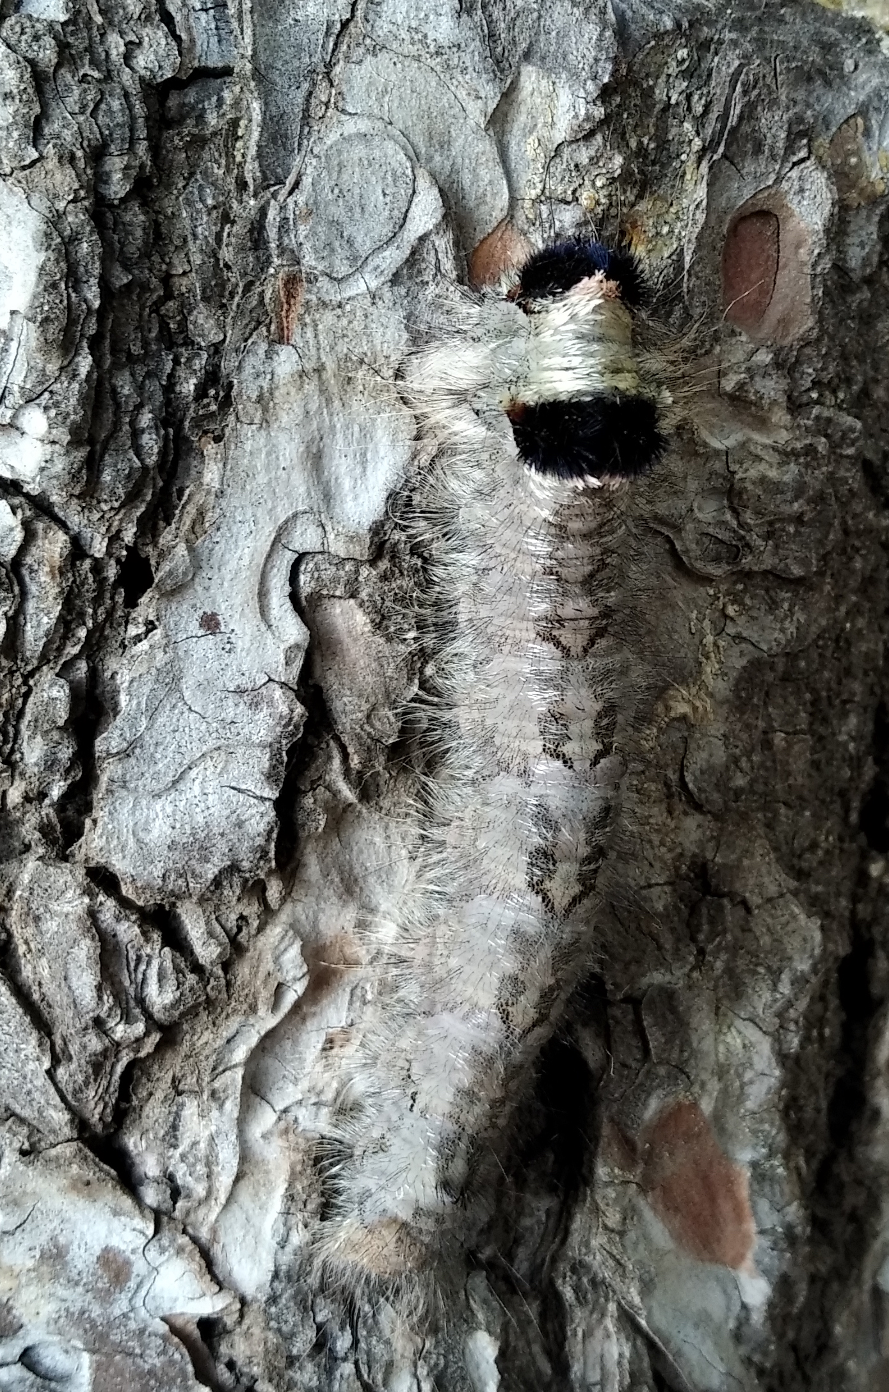
This Week with Mr. Forest
22-25/02/2021
Forest Games: Camouflages
OBJECTIVES: •Students will recognize camouflage strategies of some animals in the forest. • Students will practice their English vocabulary and oral/listening competence. • Students will play a game and associate it with strategies of fauna in the forest.
ACTIVITY: Each group gets divided into Prey (5-7) and Predators (5-8). The Prey must hide using any means from the predators within 3 minutes and a determine area. Predators then go out to search for Prey for 5 minutes. When Predator find Prey, both go to where instructor is and report their “killing”. Instructor writes and keeps count on given sheet. At the end of 5 minutes, instructor calls everyone and total the number of kills. Students then switch roles and do the same. Instructor compares kills when roles get switched. The game gets repeated once more without changing roles and after 2 searches of 5 minutes each, instructor compares numbers and discuss the strategies of prey and predators in nature.
MATERIALS:
✔️ sheet for scores
✔️pencil
AIM: For students to understand how animals in the Forest use strategies of camouflage to survive from predator.

Slide 2
This Week with Mr. Forest
22-25/02/2021
 | First Attempt | Second Attempt (Switch roles) The prey of first attempt are now predator | Third Attempt | Fourth Attempt (Roles do not switch) The predator and prey of third attempt keep their roles
How many prey at the start?
How many predator at the start?
How many prey were found at the end?

