Slide 1

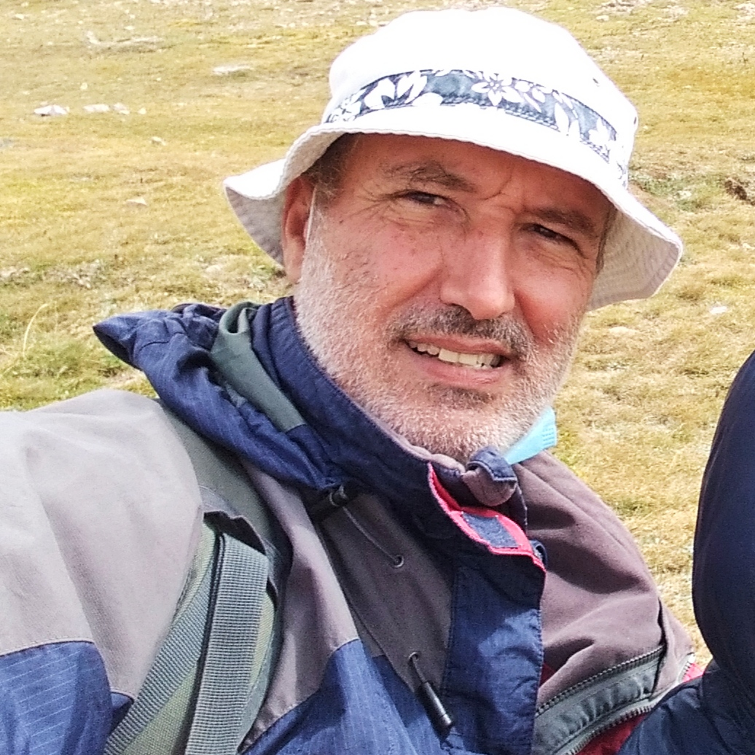
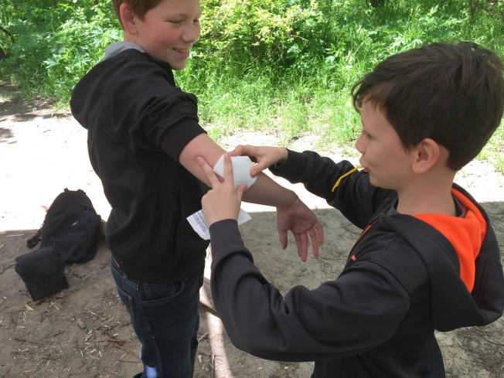
This Week with Mr. Forest
08-11/03/2021
Learning to Help an Injured Person Outdoors: The CCC & ABC of Outdoor First Aid : Part 1
AIM: For students to feel they can gain some self confidence in knowing how to help other in case of outdoors emergencies
OBJECTIVES: •Students will learn the basics of first Aid in remote places (CCC & ABC) • Students will learn how to pack a first Aid kit. • Students will practice their English vocabulary and oral/listening competence.
ACTIVITY: Instructor demonstrate principles and techniques of first aid in remote areas (CCC & ABC Check- Call-Care & Airways, Breathing, Cardiopulmonary resuscitation). Then, students will practice to basic techniques. Instructor will show how to pack a basic first Aid Kit for outdoors activity.
MATERIALS:
✔️ first aid kit
✔️ sticks from forest
✔️ cord
✔️ bandana

