Slide 1

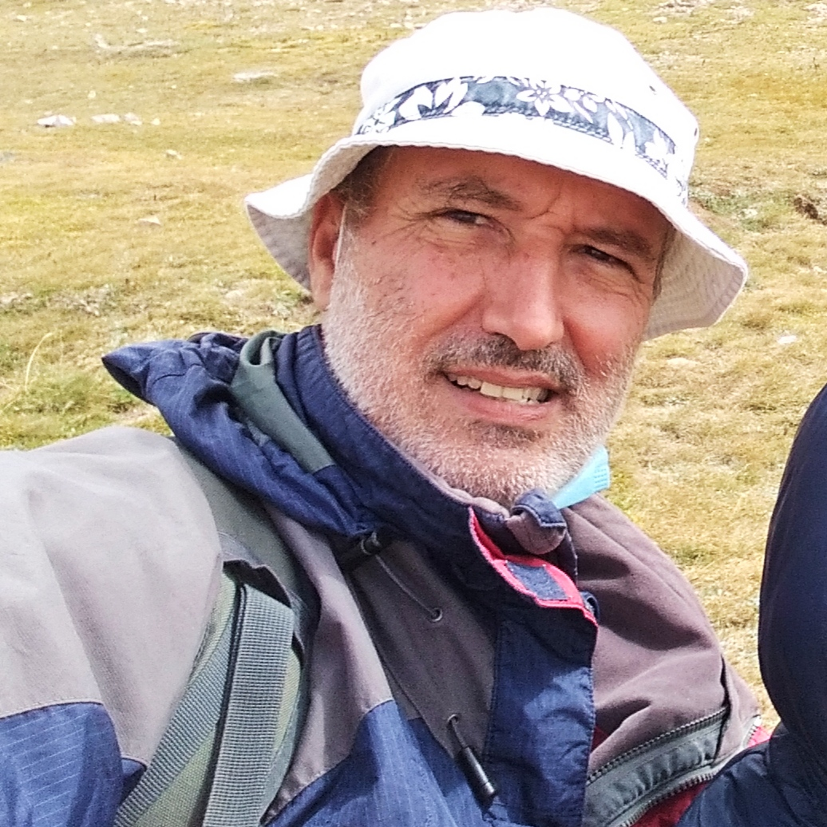
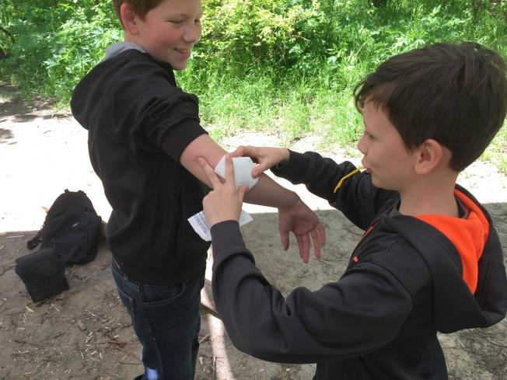
This Week with Mr. Forest
15-18/03/2021
Learning to Help an Injured Person Outdoors: The CCC & ABC of Outdoor First Aid : Part 2
AIM: For students to feel they can gain some self confidence in knowing how to help other in case of outdoors emergencies
OBJECTIVES: •Students will learn the basics tecniques of first Aid in remote places (CCC & ABC) • Students will learn how to pack a first Aid kit. • Students will practice their English vocabulary and oral/listening competence.
MATERIALS:
✔️ first aid kit
✔️ sticks from forest
✔️ cord
✔️ bandana
ACTIVITY: After a brief review of first session (CCC & ABC) students will confront 3 situation (small open wound, twisted ankle, and unconscious person on the trail) to which they must attend. Instructor will guide the intervention and make sure the safety of all.

