Slide 1
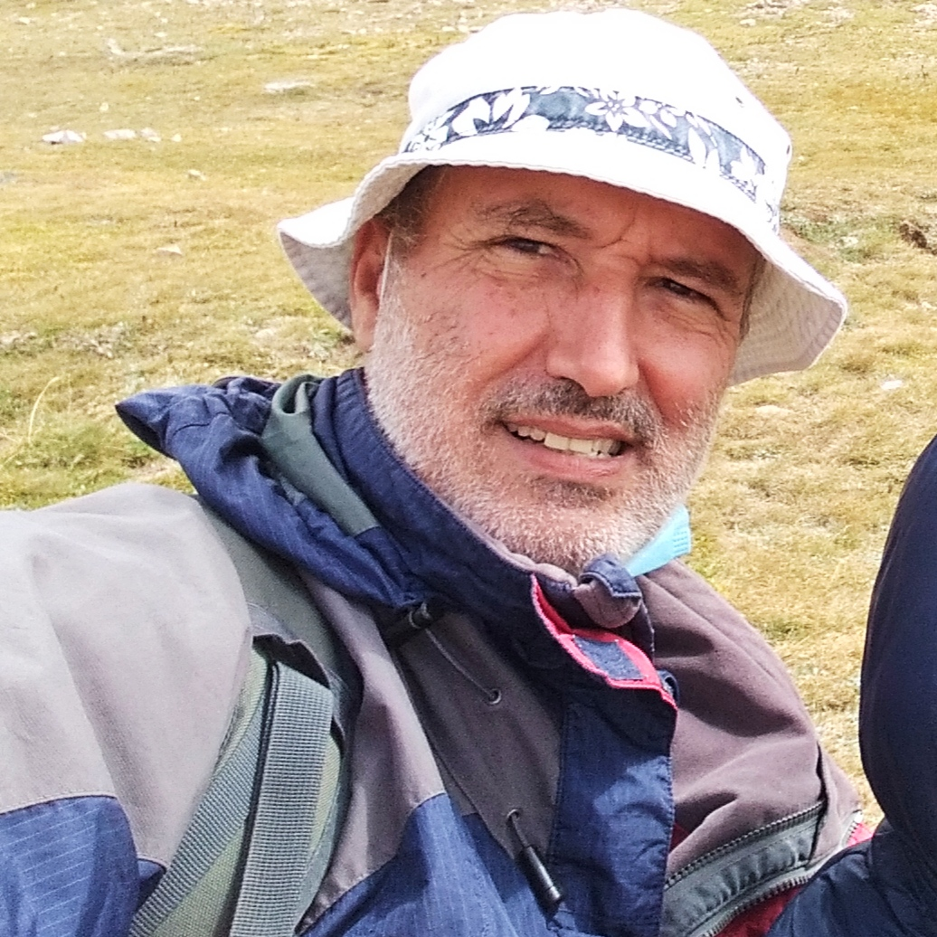
This Week with Mr. Forest
22-25/03/2021
MATERIALS:
✔️ Map of Turull Forest
✔️ “Treasure”
Students Learn Map Finding Skills
AIM: For students to recognize maps as important tools for learning about a Forest.
ACTIVITY: Students will form 3 ”explorer” groups and through the use of a map will be asked to find a “treasure” represented on the map given. The first group to find the treasure will keep it. Groups have 15 minutes to perform the search. Instructor will assist and guide students in learning to read the map.
OBJECTIVES: •Students will be able to find objects using a topographic map. • Students will learn to relate what they see to what is represented on a map. • Students will practice their English vocabulary and oral/listening competence.

