Slide 1
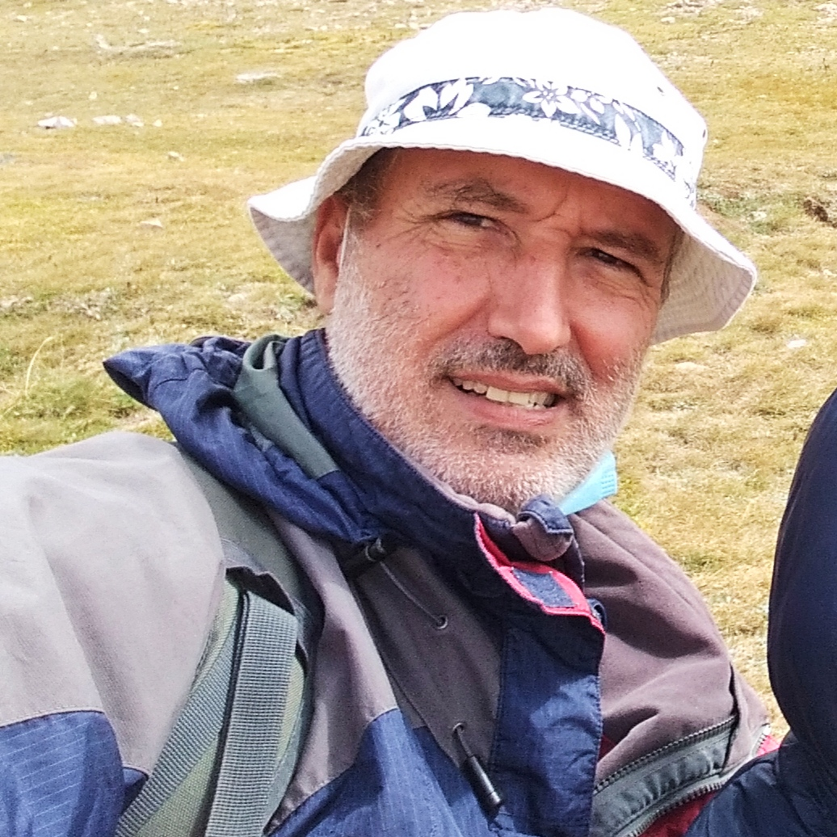
This Week with Mr. Forest
12-15/04/2021
Students Learn to Select & Make a Campsite.
MATERIALS:
✔️ Backpacks (20-30 Lt.
✔️ sleeping bag
✔️ first Aid Kit
✔️ Water (2-3 liters)
✔️ Food
✔️ Stove
✔️ Fuel
✔️ Pans
✔️ Clothing
✔️ Survival kit
✔️ Light
✔️ Topographic maps
✔️ Mat
✔️ tent
✔️ other material
How to Select a Good Campsite
https://www.youtube.com/watch?v=RdWdlkBJLJ4
AIM: For students to identify the essential elements to “live” in the Forest for 2-3 days
OBJECTIVES: •Students will be able to select a campsite, pitch a tent, and use cooking stove. • Students will know how to select a sleeping bag and mat. • Students will practice their English vocabulary and oral/listening competence.
Backpack
Shelter
Food & Cooking
ACTIVITY: Instructor will demonstrate how to pitch a 3-person tent, put a sleeping mat and bag and use cooking stove.

