Slide 1
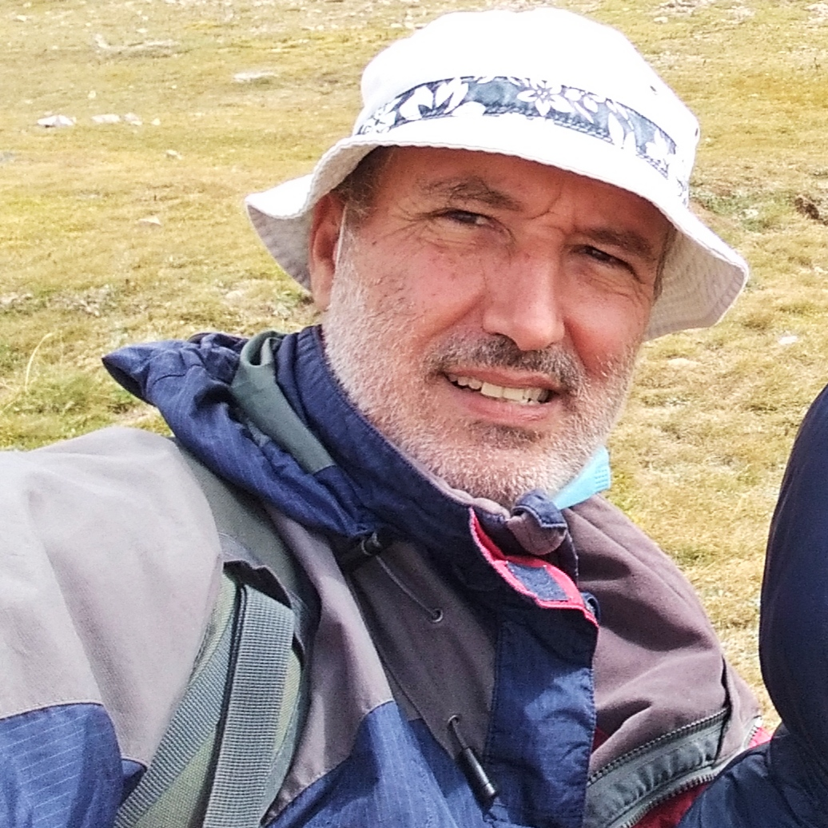
This Week with Mr. Forest
12-15/04/2021
Cooking (in the Forest) with Mr. Forest
MATERIALS:
✔️ Backpacks (20-30 Lt.
✔️ sleeping bag
✔️ first Aid Kit
✔️ Water (2-3 liters)
✔️ Food
✔️ Stove
✔️ Fuel
✔️ Pans
✔️ Clothing
✔️ Survival kit
✔️ Light
✔️ Topographic maps
✔️ Mat
✔️ tent
✔️ other material
Backpacking cooking: https://www.youtube.com/watch?v=g0h7Szg0bWk
AIM: For students to learn to cook in the Forest for 2-3 days
OBJECTIVES: •Students will be able to select, and cook food for camping.. • Students will know how safety operate a cooking stove. • Students will practice their English vocabulary and oral/listening competence.
Backpack
Shelter
Food & Cooking
ACTIVITY: Instructor will show different cooking materials, and demonstrate how to operate a mini stove. Together we’ll eat a meal.

