Slide 1
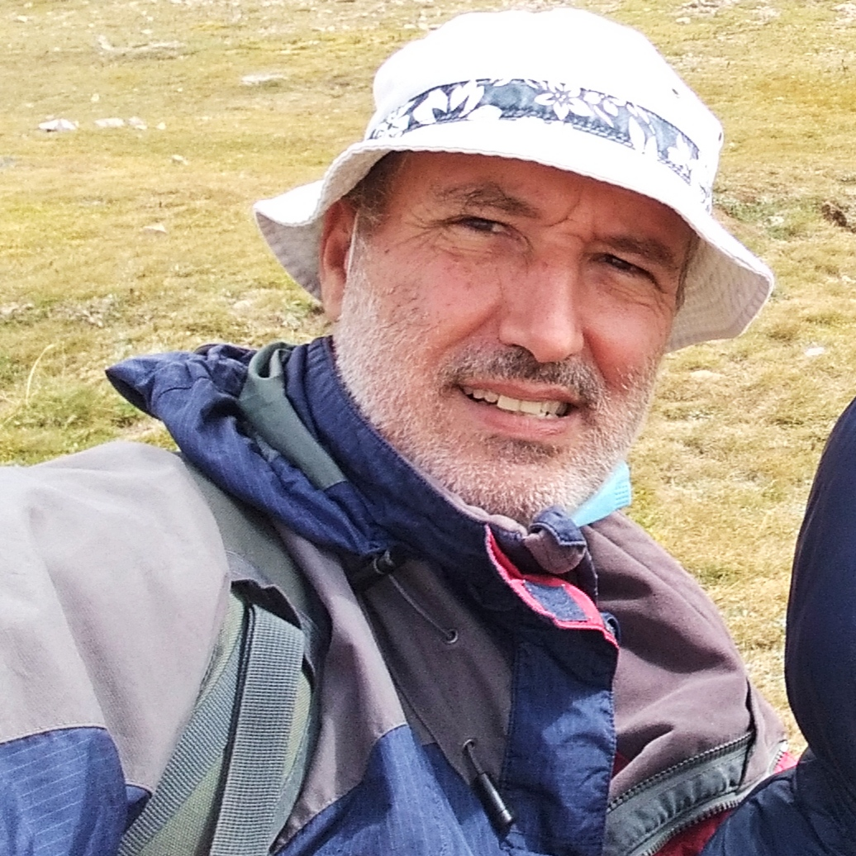
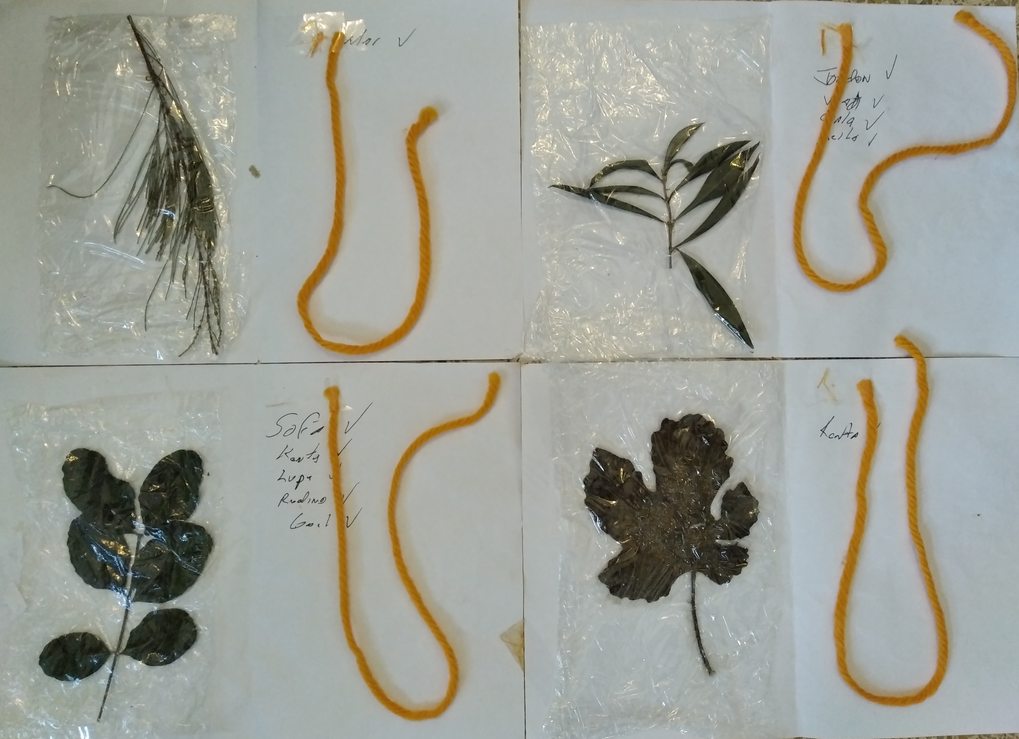
This Week with Mr. Forest
Dec.7-10/2020
Treasure Hunt: Identify a Plant by its Leaves!!
Recognizing the Diversity of Plants in the Turull Forest
AIM: For students to recognize the diversity of flora in the Forest Turull through a game.
Activity: Students are taken to a particular place in the Forest Turull and asked to find and tag a plant using an identification key they have with them (see Photo on the right). Once found, they use the orange cord to tag the plant and their name is written on the card.
OBJECTIVES: • Students will be able to identify a tree/plant by its leaves • Students will practice their English vocabulary and oral competence (names of plants, medicines, etc.) • Students will
MATERIALS:
✔️ Card with representative leaf,
✔️ colored cord (see photo)

