Slide 1
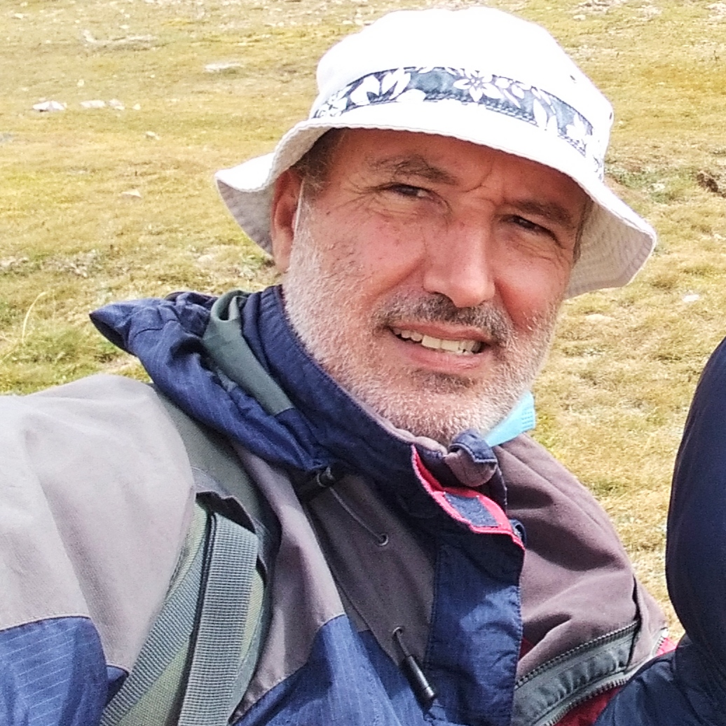
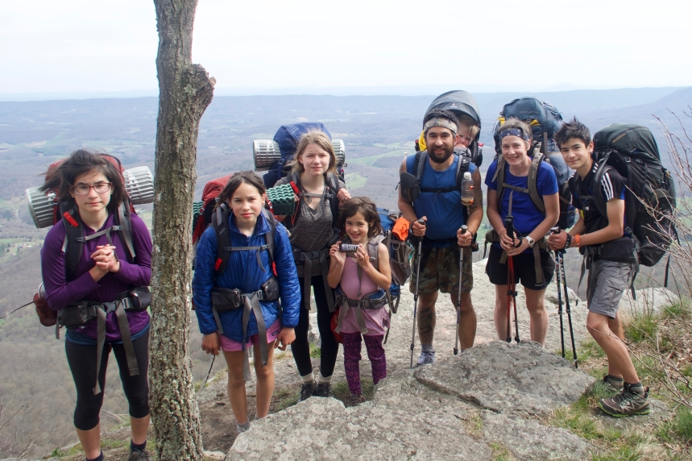
This Week with Mr. Forest
6-9/04/2021
Students Learn to Pack a Backpack for an Outdoor Outing
AIM: For students to identify the essential elements to “live” in the Forest for 2-3 days
OBJECTIVES: •Students will be able to pack correctly a backpack for a 2-3 day trip • Students will be able to group all materials and place them in backpack. • Students will practice their English vocabulary and oral/listening competence.
MATERIALS:
✔️ Backpacks (20-30 Lt.
✔️ sleeping bag
✔️ first Aid Kit
✔️ Water (2-3 liters)
✔️ Food
✔️ Stove
✔️ Fuel
✔️ Pans
✔️ Clothing
✔️ Survival kit
✔️ Light
✔️ Topographic maps
✔️ Mat
✔️ tent
✔️ other material
ACTIVITY: Instructor shows how to pack a backpack using an effective weight distribution for a child/youth b/ween 7-12 years old. Students practice the skill.
2-4 years old: Under 10L
4-7 years old: 10-20L
7-10 years old: 18-30L
10-17 years old: 30+L
https://www.youtube.com/watch?v=xeFpxG9-1Cw

