Slide 1
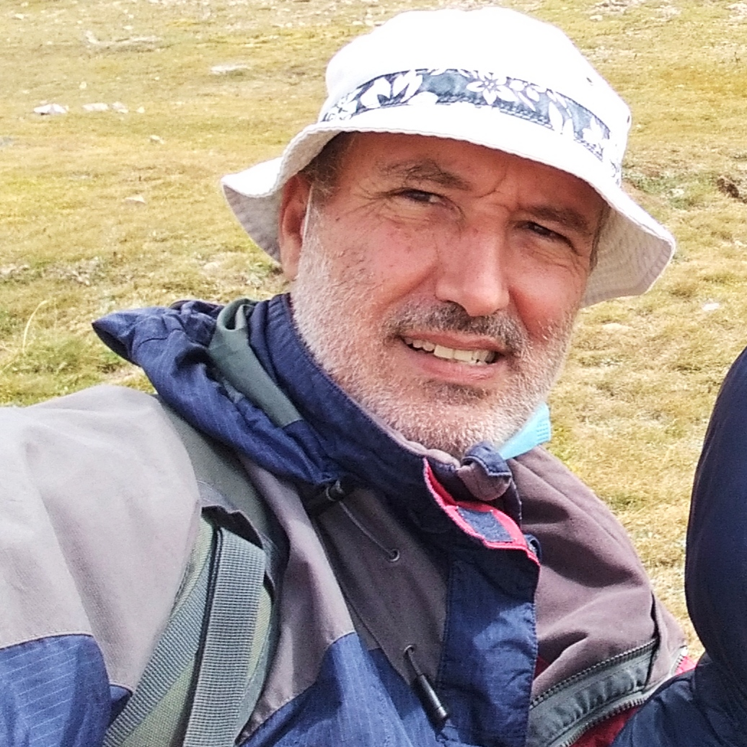
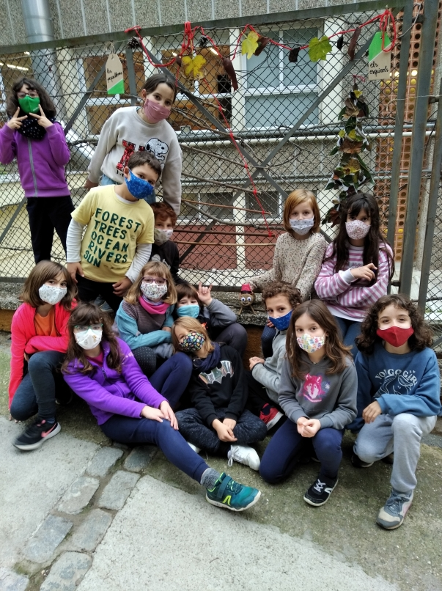
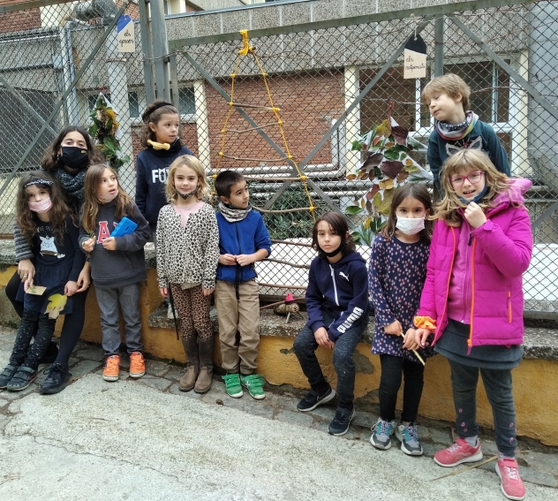
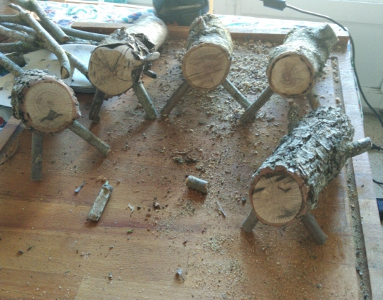
This Week with Mr. Forest
14-17/12/20
Using Forest Materials to Create Decorations for the Holidays
AIM: We wish for students to recognize that we can decorate our festivities with materials from the forest (leaves, sticks, tree bark, little stones, etc.)
OBJECTIVES: •Students will learn how to construct a natural bird feeding station. • Students will practice their English vocabulary and oral competence. • Students will understand the cyclic nature of forests (how food is produced and consumed in the forest).
MATERIALS:
• Bags for collection
• Glue
• Holiday lights
• cord for trees
• 10cm x 30cm tree trunk (tío)
• foam patterns for trees.
• dried leaves from forest
• sticks of different diameters and length from forest

